Slide 1

Pre-Offer Outreach for the
Round Valley Indian Tribes
www.doi.gov/buybackprogram

Slide 2

Presentation Overview
Introductions
History of the Land Buy-Back Program
Program Roll Out
Appraisals and Mineral Evaluations
Purchase offer process
Q & A

Slide 3

Introductions
Your Land Buy-Back Program Team
Santee Lewis, Senior Advisor on Tribal Relations (Buy-Back Program, located in New Mexico)
Diana Wuerth and Gina Yazzie, Fiduciary Trust Officers (OST)
Zan Spurlock, Program Specialist (Buy-Back Program/OST)
Acquisition Center – (BIA, Billings, Aberdeen, Dallas)
  Land Evaluation (BLM, DME, OAS, BIA)
  RVIT-LBBP staff: Renae Britton, Lynette Benton, Mona Oandasan and Deb Hutt
Notes:
Describe team present and their role at event to landowners. Do not forget to refer to the tribe and the tribe’s outreach team if applicable. Speaker’s choice to “introduce” team present at event or whole team, although whole team provided later.
memorize these sub bullets
Senior Advisor on Tribal Relations (Buy-Back Program, located in XX) –
Provides consistent point of contact
Oversees cooperative agreement process from the application development through the implementation
Fiduciary Trust Officer (OST, XX)
Local representative, working with Tribe on Trust matters
Assisting Land Buy-Back on outreach efforts
Program Specialist (Buy-Back Program/OST)
Regional outreach providers, get the word out to beneficiaries
Use multiple means to contact and inform
Acquisition Center – (BIA, Billings, Aberdeen, Dallas)
Prepare and send out offers
Pay out accepted offers
Land Evaluation (BLM, DME, OAS, BIA)
Presenter should modify as appropriate. Other potential speakers include:
Bureau of Land Management
Responsible for mapping lands under tribal jurisdiction
Works with tribes to resolve mapping discrepancies
Division of Mineral Evaluations
reviews identified parcels for mineral potential
Categorizes tracts with nominal mineral value
Office of Appraisal Services (OAS)
Responsible for appraising land
Works with tribes to gather information necessary to determine the lands’ fair market value

Slide 4
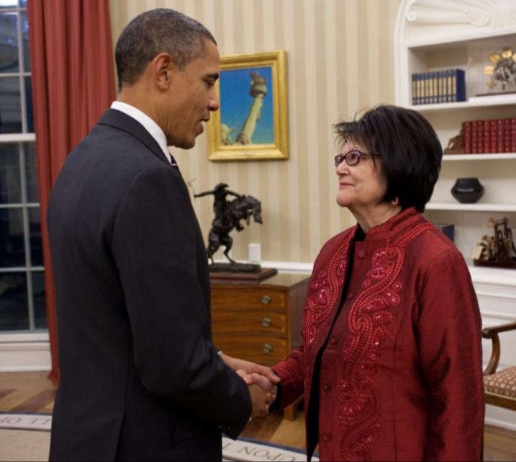
What is the Buy-Back Program?
Created to implement the land consolidation component of the Cobell Settlement Agreement, The Settlement provided a $1.9 billion fund to purchase:
fractional interests
in trust or restricted land
at fair market value
from willing sellers
within a 10-year period
Goal: Keeps land in trust - purchased lands are immediately held in trust for the recognized tribe jurisdiction over the land.
President Barack Obama with the late American Indian Activist Elouise Cobell
Notes:
The Fund is made up of $1.55 billion for acquiring fee interests, a maximum of 15% of the total $1.9 billion fund ($285 million) of the for implementation costs, and $60 million for Scholarship Fund contributions

Slide 5
What is the Buy-Back Program?
Collaborative Effort
To reduce the number of fractional interests in tracts of trust or restricted lands.
Fractionated tracts are defined as any tract with more than one landowner.
Landowner
Tribe
DOI
Program Office
BLM
DME
OAS
BIA (AC, LTRO, Local Agencies)
OST (Trust Services, Field Operations, TBCC)
Notes:
Notes re org within DOI
The Bureau of Land Management (BLM) produces geodatabases and initial mapping products, BLM works with the Bureau of Indian Affairs, Land, Titles, and Records Office (BIA LTRO) and the Program to resolve mapping discrepancies on tracts to allow the Program to appraise the land, if possible
The Office of Valuation Services, Division of Minerals Evaluations (DME) is responsible determining which tracts have nominal (de minimis) mineral values, and which tracts may have Stage 2 or Stage 3 (>de minimis, potential mineral value) mineral values so that the Program does not send offers for interests on that land
BIA Forestry is responsible for timber valuations, if applicable
The Office of the Special Trustee for American Indians (OST), Office of Appraisal Services (OAS) is responsible for appraising tracts of land and incorporating any contributory value from timber and mineral estates
BIA and “638” compacting/contracting tribes are responsible for providing timber values
All appraisal methods used by DOI will conform to the Uniform Standards of Professional Appraisal Practice (USPAP)
To ensure a credible and robust valuation process, DOI worked with the non-profit Appraisal Foundation (TAF) to obtain an independent review of DOI’s methods
Land valuation will rely heavily on mass appraisal valuation techniques

Slide 6
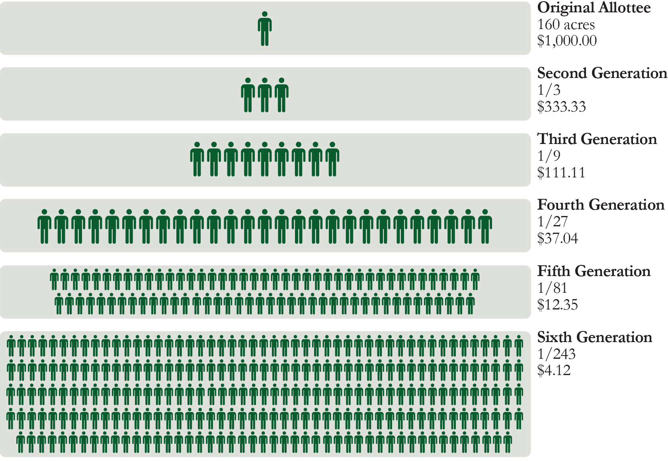
Fractionation
A serious problem facing tribal communities
As tracts (or allotments) of lands are passed down through generations, they gain more and more individual owners.
Because the number of owners make it difficult to use the land, these allotments often lie idle and cannot be used for any beneficial purpose.
There are approximately 150 tribal locations with fractionated land, with approximately 245,000 unique owners.
For illustrative purposes only
Notes:
Explain concept of common areas and undivided interests
Hold up a bottle of water and analogize to tract of land owned by many people. An undivided interest is similar to an individual owner who has a drop or several drops of interest in a bottle of water, but no particular drop in the bottle is theirs. Therefore, both the small amount of water interest and in no particular place can make it difficult to use the land

Slide 7
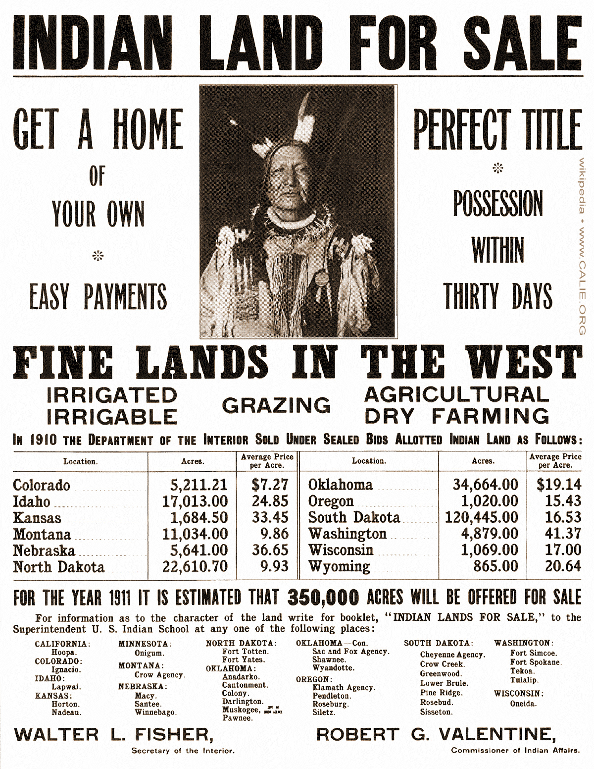
Why is land consolidation important?
Prevents loss of land
Strengthens tribal sovereignty
Promotes better land use
Keeps income in Indian communities
Advertisement from the Department of the Interior, circa 1911
Notes:
Prevents loss of land: Every year, land goes out of trust simply because fractionated interests are passed on to non-Indian heirs. The Buy-Back Program will help stop this loss of Indian lands by transferring those interests to the tribe, forever preventing further fractionation.
Strengthens tribal sovereignty: Land consolidation increases the ability of tribal governments to make decisions about the land
Promotes better land use: Returning these lands to tribes through purchases from landowners has potential to spur economic development and restore tribal homelands
Keeps income in Indian communities: Income received from the land is divided to the extent that many individual owners receive only pennies, and the money often does not stay in the Indian communities that need it most

Slide 8
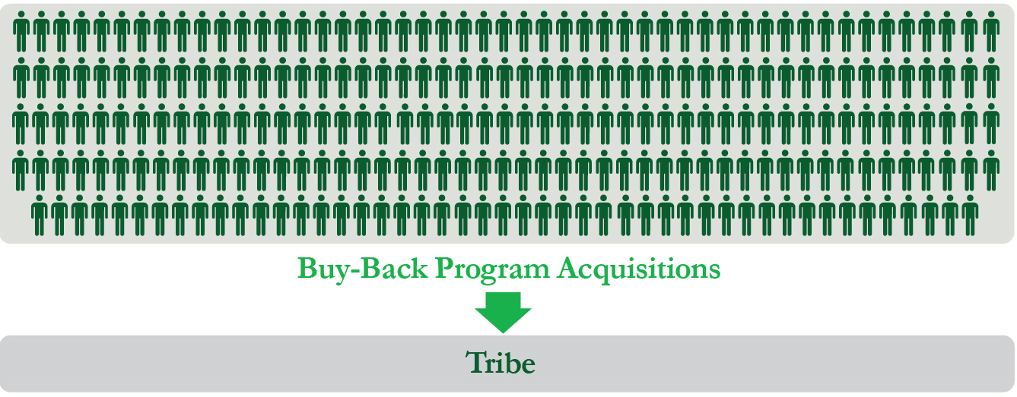
How Does the Program Work?
  The Buy-Back Program makes offers to purchase fractional interests in trust or restricted lands (tracts with more than one owner).
  Landowners can choose to sell some, all, or none of their fractional land interests. Participation in the Program is strictly voluntary.
  Landowners will receive payments in their Individual Indian Money (IIM) accounts for interests that they choose to sell.
  Purchased interests will be immediately held in trust for the tribe with jurisdiction over the land.
Tribal Nation
Notes:
The purchase offers are made at fair market value, based on appraisal and are not negotiable.

Slide 9

Program Priorities?
Landowners: Foster informed landowners; responsible decision making; and Program participation.
Tribes: Strengthen partnerships and respect and uphold tribal sovereignty. Tailor efforts to each location based on tribal involvement and priorities.
Timely use of the Fund: Expend the Trust Land Consolidation Fund by purchasing land from interested landowners to reduce fractionation and expand tribal ownership. Remain flexible and open to constant learning and improvement.
Notes:
Note: The Fund should be used within the 10-year time frame ending November 2022 according to the Settlement.

Slide 10

Major phases of the Program?
    Outreach: Inform landowners about the Buy-Back Program, answer questions, and assist tribes with identifying their priority tracts for acquisition.
    Land research: Collect information necessary to establish fair market value for fractionated tracts that might be acquired.
    Land valuation: Determine the fair market value of tracks where DOI will offer to buy fractional land interests.
    Land acquisition: Purchase interests in fractionated tracts that individuals would like to voluntarily sell.
Notes:
1- Outreach occurs throughout the process (from the cooperative agreement signing to closeout of Program with the tribe)
2- Land Research is done by (DME, BLM, BIA) – expand on what each group is doing
Note from OAS- Land research consists of inventorying all the legal, social and physical characteristics or attributes of every tract. It necessarily involves many different agencies. BIA for example, because they maintain the title/legal information for every tract; BLM for the mapping; DME for the mineral rights; Forestry for the timber component; OAS for market and physical characteristics, etc., etc.
3- Valuation
Note from OAS- Regardless of the method used, I believe it is important to emphasize that all appraisals performed for the program have the same objective, which is to determine the 'fair market value' of the property. OAS will employ whatever appraisal methodology is best suited to meet the needs of each location, based on the most efficient allocation of program resources. All program appraisals, regardless of methodology, adhere to established appraisal standards.
4- Acquistion - purchase

Slide 11
Who is Responsible for Land Valuation?
The Office of the Special Trustee for American Indians (OST), Office of Appraisal Services (OAS) is responsible for appraising tracts of land and incorporating any contributory value from timber and mineral estates.
The Division of Minerals Evaluations (DME) is responsible for the valuation of mineral interests.
BIA and “638” compacting/contracting tribes are responsible for providing timber values.
All appraisal methods used by DOI conform to the Uniform Standards of Professional Appraisal Practice (USPAP).
To ensure a credible and robust valuation process, DOI worked with the non-profit The Appraisal Foundation (TAF) to obtain an independent review of DOI’s methods.

Slide 12

Mineral Evaluations
Notes:
Presenter may choose to explain the difference between the terms tracts and parcels:
Tracts and Parcels (excerpt from the Status Report)
A tract of land, as referenced throughout this Report, is the real property trust asset in which an individual or tribe has an ownership interest. It is a defined area, often the boundary of an original allotment, and can include the surface estate, mineral estate, or both. A tract can be owned by one or more individuals and tribes. A tract with multiple owners is considered a fractionated tract.
A tract of land can be composed of one or more parcels. Parcels also have defined areas, but are not necessarily adjoining plots of land. In other words, a tract may be composed of just one single parcel of land, multiple adjacent parcels, and in some instances multiple non-adjacent parcels that are separated by other tracts or parcels of land. A landowner owns an interest in a tract, not in a particular parcel.
Offers for the Buy-Back Program are made at the tract level. If a tract contains a parcel that cannot be appraised, then offers for interests in the whole tract cannot be made.

Slide 13
Mineral Evaluations
The Office of Valuation Services, Division of Minerals Evaluations (DME) reviews identified parcels for mineral potential, and categorizes these parcels in three stages:
  Stage 1: Have minerals with no present economic value
  Stage 2: Have minerals with potential for economic value and need further analysis to establish value
  Stage 3: Have minerals with demonstrated economic value and need further analysis to establish current value
  Note: The Program policy is not to make offers for interests on tracts identified as Stage 2 or Stage 3.
Notes:
Presenter may choose to explain the difference between the terms tracts and parcels:
Tracts and Parcels (excerpt from the Status Report)
A tract of land, as referenced throughout this Report, is the real property trust asset in which an individual or tribe has an ownership interest. It is a defined area, often the boundary of an original allotment, and can include the surface estate, mineral estate, or both. A tract can be owned by one or more individuals and tribes. A tract with multiple owners is considered a fractionated tract.
A tract of land can be composed of one or more parcels. Parcels also have defined areas, but are not necessarily adjoining plots of land. In other words, a tract may be composed of just one single parcel of land, multiple adjacent parcels, and in some instances multiple non-adjacent parcels that are separated by other tracts or parcels of land. A landowner owns an interest in a tract, not in a particular parcel.
Offers for the Buy-Back Program are made at the tract level. If a tract contains a parcel that cannot be appraised, then offers for interests in the whole tract cannot be made.

Slide 14
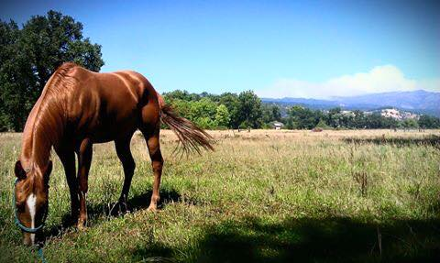
Appraisals
Notes:
Presenter may choose to explain the difference between the terms tracts and parcels:
Tracts and Parcels (excerpt from the Status Report)
A tract of land, as referenced throughout this Report, is the real property trust asset in which an individual or tribe has an ownership interest. It is a defined area, often the boundary of an original allotment, and can include the surface estate, mineral estate, or both. A tract can be owned by one or more individuals and tribes. A tract with multiple owners is considered a fractionated tract.
A tract of land can be composed of one or more parcels. Parcels also have defined areas, but are not necessarily adjoining plots of land. In other words, a tract may be composed of just one single parcel of land, multiple adjacent parcels, and in some instances multiple non-adjacent parcels that are separated by other tracts or parcels of land. A landowner owns an interest in a tract, not in a particular parcel.
Offers for the Buy-Back Program are made at the tract level. If a tract contains a parcel that cannot be appraised, then offers for interests in the whole tract cannot be made.

Slide 15
Individual Site-Specific (Single Property) Appraisals
When the number of appraisals to be done does not support mass appraisal, or when properties do not have a similar enough use or an active sales market (comparable sales).
Often sales in the area are compared to the property being appraised and differences are used to adjust the value of the property being appraised up or down to determine the fair market value (FMV)
Example
  Property types requiring more detailed analysis, such as commercial, industrial, mixed-use, etc.
Notes:
The Program will use individual site-specific appraisals in situations where appraisers have determined that the land use types (e.g., commercial, industrial, recreational) or highest and best use within a well-defined project area are not homogeneous, and/or they are complex. The Program may also use individual site-specific appraisals when there are few tracts of land requiring appraisal. OAS Appraisers will adhere to USPAP standards 1 and 2 in the development and report writing for site-specific appraisals.

Slide 16
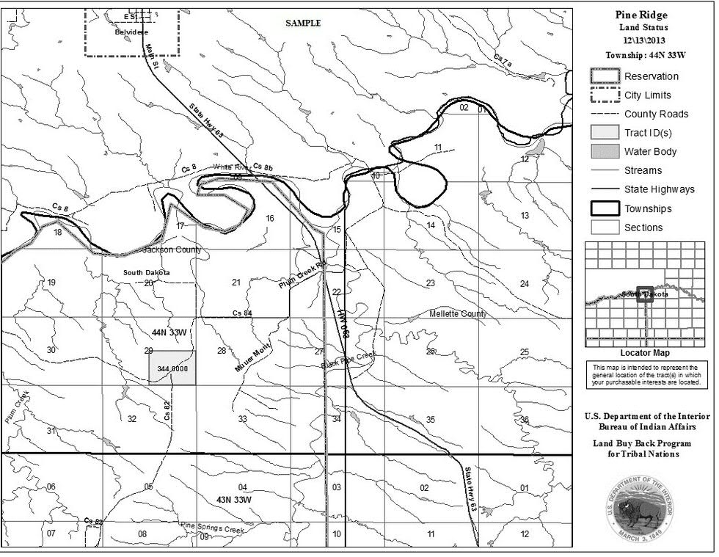
How Will I Be Contacted to Participate in the Program?
Eligible landowners will be mailed a purchase offer package which includes a cover letter, instructions, deed, inventory and maps.
    Note: Not all landowners will receive a purchase offer package.
Notes:
Mention Indian Land Tenure Foundation; post-offer outreach workshops in April, notary services at workshops for free

Slide 17
OVERVIEW
Sample offer package

Slide 18
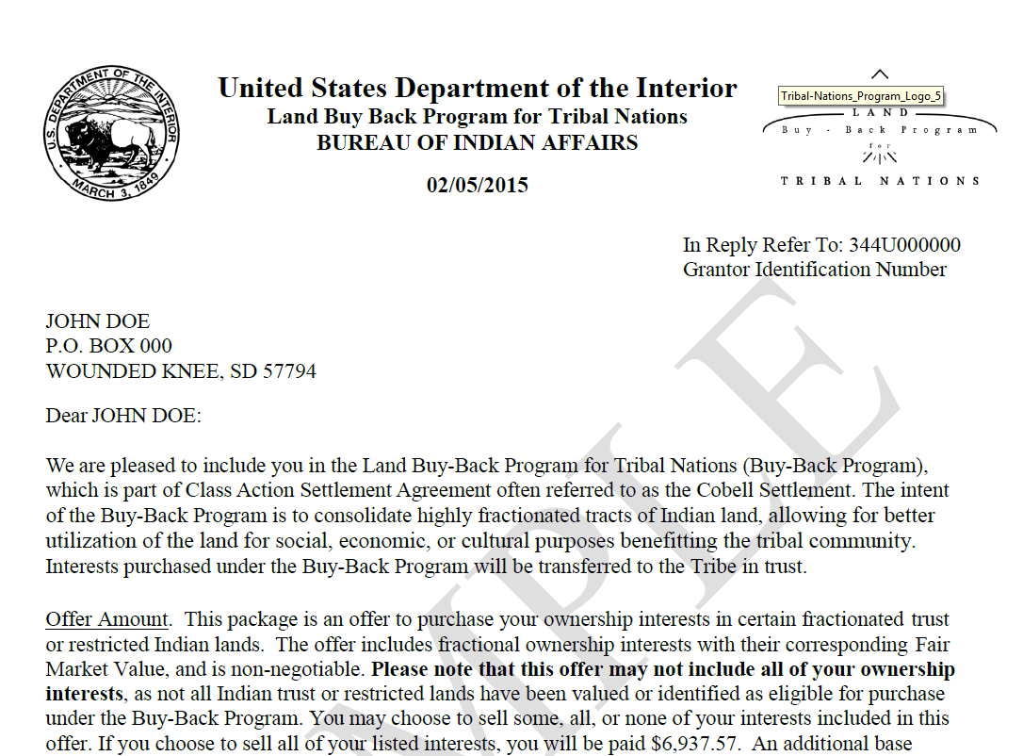
Sample Offer Package
Cover letter
Notes:
From the date of the letter, landowner has 45 days to return all pertinent documents; signed and notarized.

Slide 19
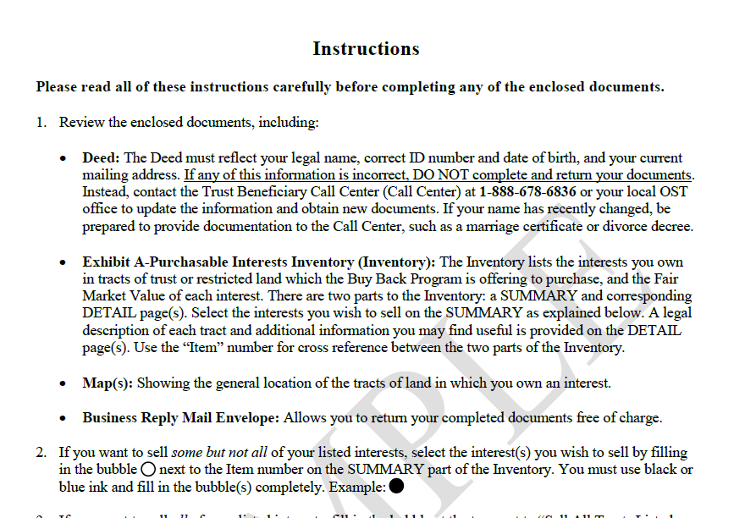
Sample Offer Package
Instruction sheet
Notes:
Instructions inform you of the requirements needed to process your Purchase Offer documents. Do not sign or write on any document until you are sure of what you want to do. Return all documents with a ‘barcode’. Do not write on these documents. You may want to make a copy of all the documents so you can work on them. If you do make copies, make sure that you mark them “Copy” so that you will only send in the originals.

Slide 20
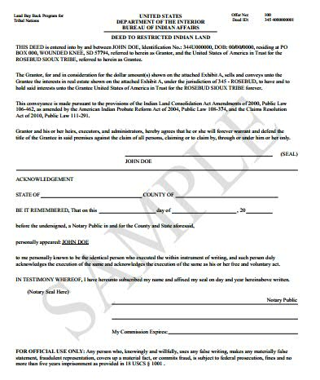
Sample offer package
Deed
Notes:
Do not sign the top portion of the document until you are in front of a Notary. The Notary will fill-out and sign the bottom portion.

Slide 21
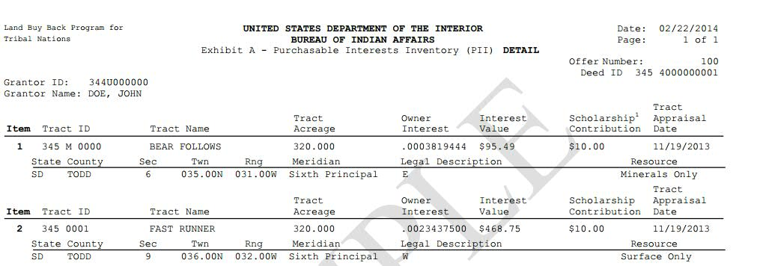
Sample Offer Package
Purchasable interests inventory report
Notes:
The PII report can be printed out for landowners at any of the Pre-Offer workshops by OST or a Cobell supervisor.

Slide 22
Sample Offer Package
Map(s)
Notes:
Each landowner will receive a copy of a map to their land tract.

Slide 23
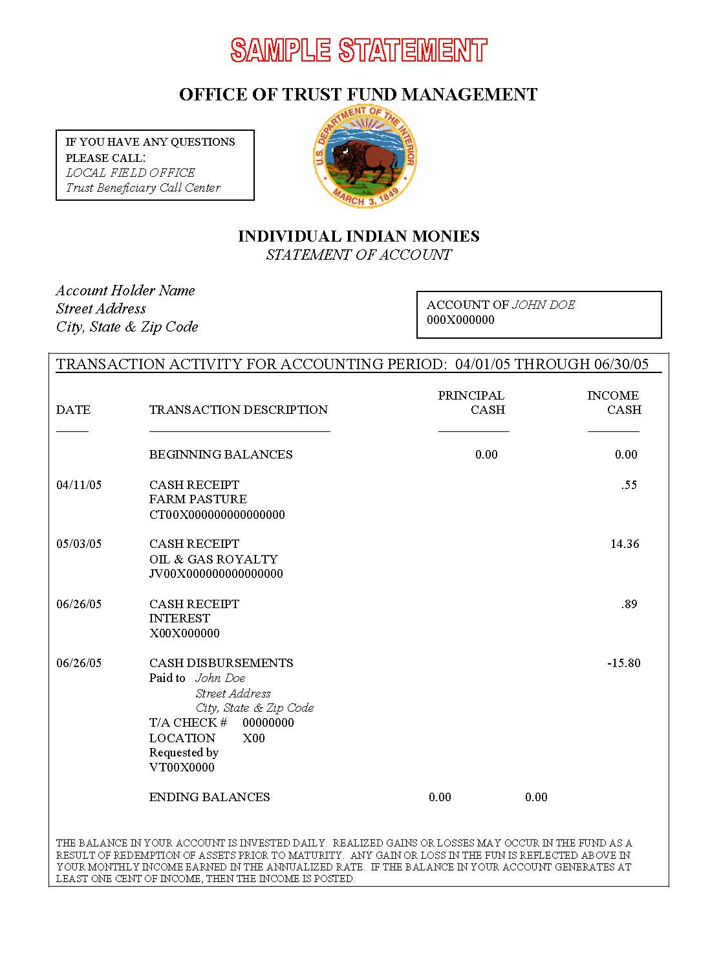
How will I be compensated for my land if I choose to sell?
  Fair market value: Determines the amount that a landowner will be offered for their ownership interest in a fractionated tract.
  $75 base payment: The Program provides landowners with a base payment of $75 per purchase offer, compensates landowners for the time and effort to complete the purchase offer process.
  Funds will be deposited into the landowner’s IIM account.
Notes:
The OST presentation will go further into detail regarding the IIM accounts.

Slide 24
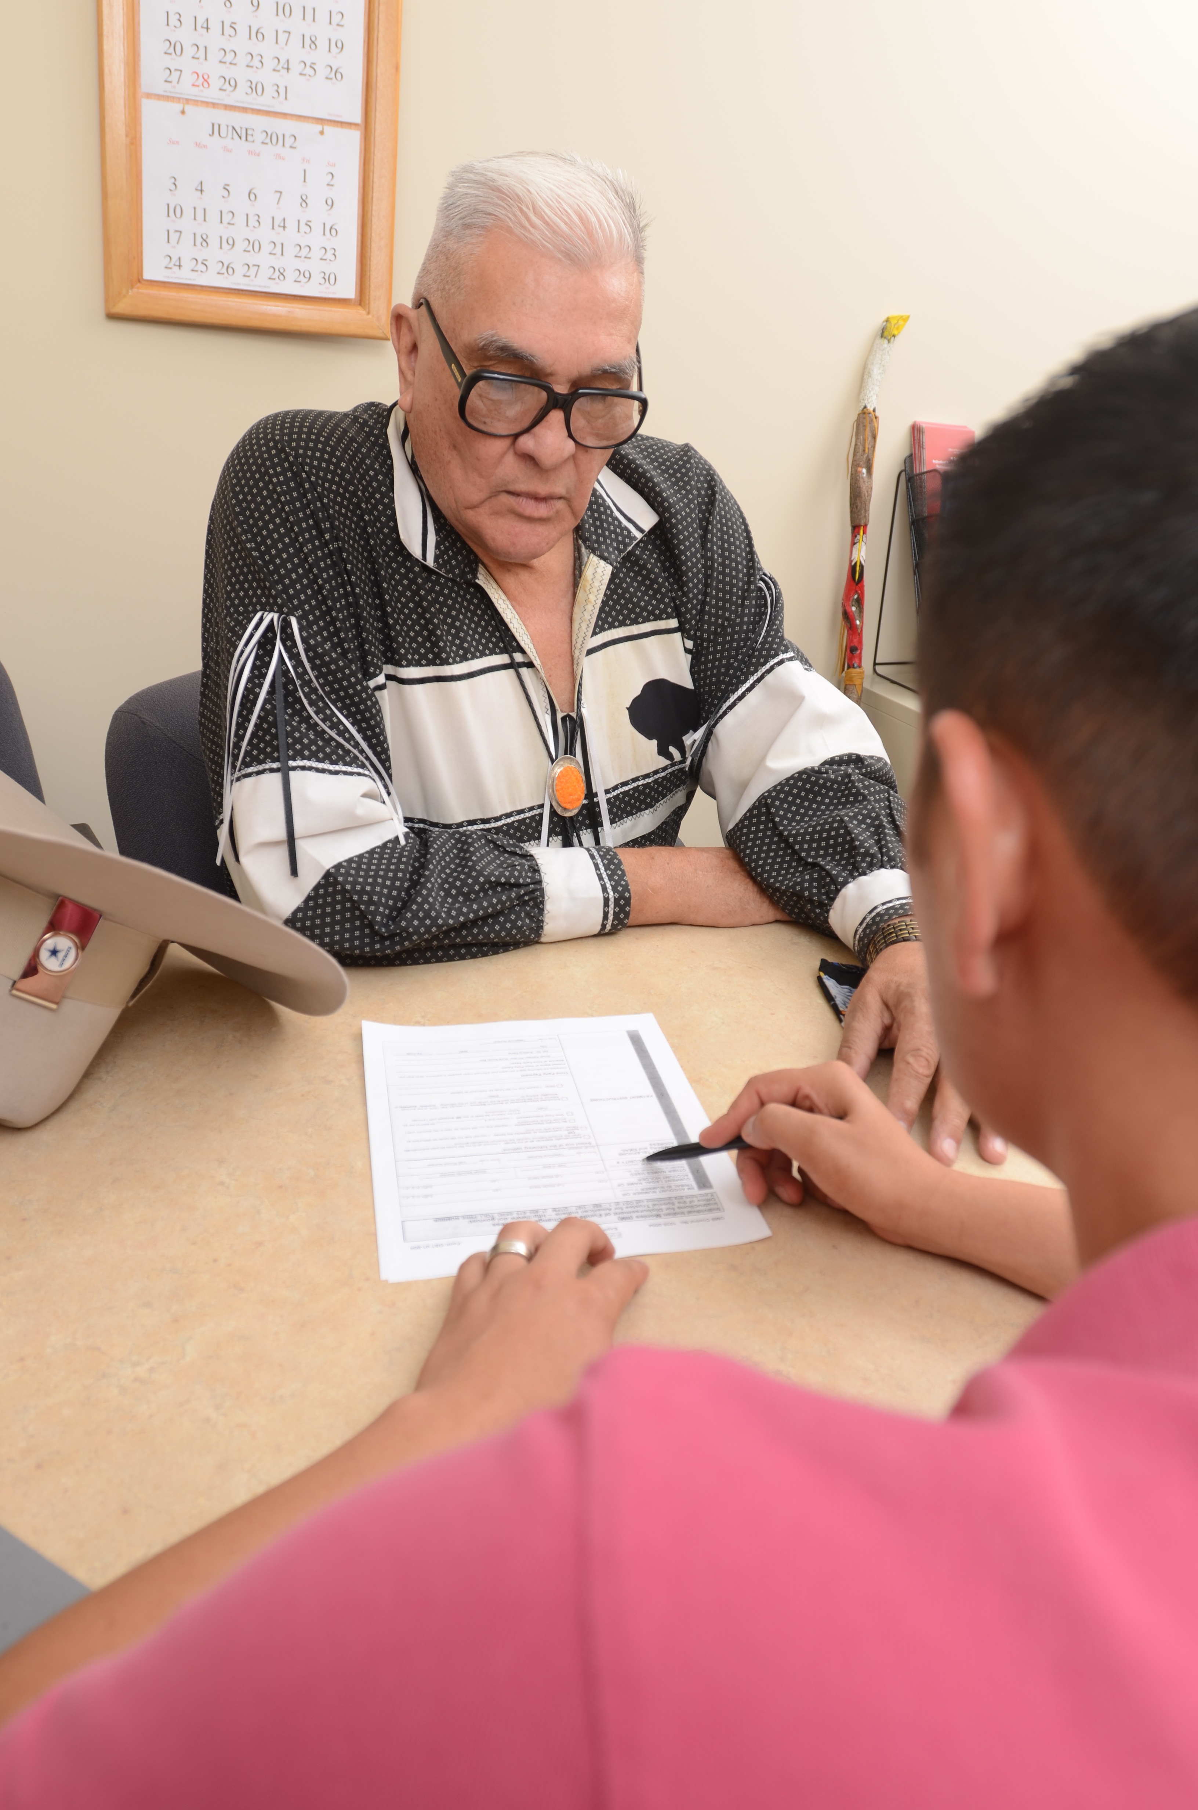
How do I complete the purchase offer package?
Verify that your name and address are correct on the deed.
Select the interest(s) you are interested in selling, sign the deed exactly as your name appears on the document in the presence of a notary public (available at outreach events and Office of the Special Trustee for American Indians [OST] field offices).
  See Informing Indian Landowners on the Land Buy-Back Program Pamphlet for more information
Note: Landowners have a set amount of time to decide whether to sell some or all of their fractional interests.
  Packages must be completed and postmarked/returned on or before the end of the 45 calendar days to be processed.
Notes:
The offer expiration (“return by date”) is provided in the purchase offer cover letter; it is the date of the letter.

Slide 25
Things to consider
If you live on or make use of the land, visit your local Bureau of Indian Affairs (BIA) Real Estate Service Office to make sure that a valid lease or land use permit is in place.
If you sell your land interest, you will no longer receive any income produced from that tract of land.
The value of minerals and timber is taken into account during the appraisal process (minerals cannot be split off from surface interests, doing so would increase fractionation).
If you decide not to sell your land, you may wish to talk with OST or BIA about planning to pass on your land to minimize future fractionation and ensure your plans are carried out.
Notes:
Detailed information on estate planning or alternatives to selling will be presented by OST.

Slide 26
Making an Informed Choice About Your Land
If you choose not to sell your land, it is important to consider how to best utilize the property during your lifetime and how to most efficiently pass it to your intended beneficiaries upon your death. Federal rules and tribal codes govern the estate planning options that may be available to you. Some of these options cannot be rescinded after a decision is made, so it is critically important to make informed decisions about your land interests and estate planning options
The Office of the Special Trustee for American Indians (OST) has partnered with a number of tribal organizations, legal aid services, and law schools to help provide Indian trust beneficiaries with resources to assist with estate planning. For more information, you may:
  Contact OST’s Trust Beneficiary Call Center (TBCC)
  Contact your local Fiduciary Trust Officer (FTO)
  Visit OST’s financial empowerment website at: http://www.doi.gov/ost/individual_beneficiaries/ financial_empowerment/index.cfm.

Slide 27
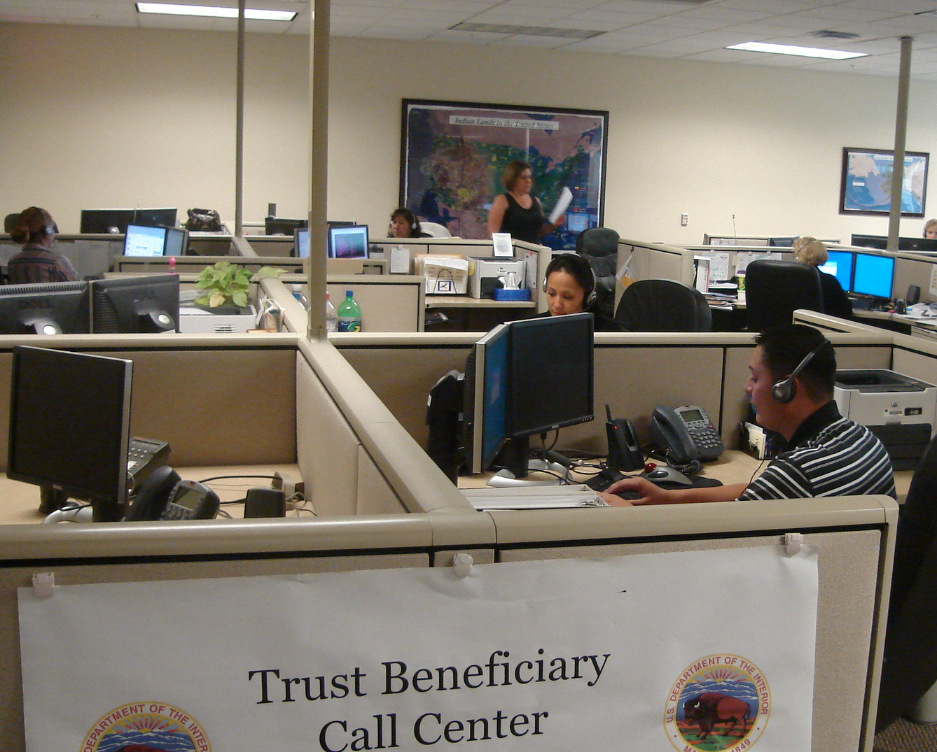
What is my first step as a landowner?
Call the Trust Beneficiary Call Center (TBCC)
(888) 678-6836
  Hours (mountain time)
  Monday - Friday: 7:00 a.m. to 6:00 p.m.
  Saturday: 8:00 a.m. to noon
  Ensure your contact information is correct.
  Ask any questions you may have about the Program.
  Register as a willing seller.
  The TBCC is a centralized location for questions and timely responses.
Notes:
Please note that if a landowner is registering as a willing seller that it is not a commitment to sell.

Slide 28
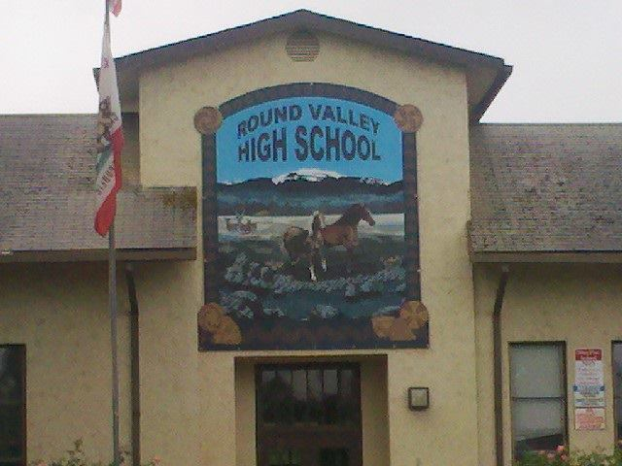
Cobell Education Scholarship Fund
For every interest sold, a contribution (up to $60 million) will be made to the Cobell Education Scholarship Fund (Scholarship Fund).
The Scholarship Fund provides financial assistance to American Indian and Alaskan Native students attending post-secondary vocational schools or institutions of higher education.
The Scholarship Fund is administered by the American Indian Graduate Center in Albuquerque, NM.
Amount contributed to date:
$19.5 million as of June 30, 2015
Notes:
On January 6, 2016, the U.S. Department of the Interior announced that it has transferred $4 million to the Cobell Education Scholarship Fund, bringing the total transferred funds to nearly $35 million.

Slide 29

Whereabouts Unknown
FACT:
OST does not have current contact information for approximately 33,000 beneficiaries, referred to as “WAU”
OST Website: http://www.doi.gov/ost/wau/index.cfm
      Search list of whereabouts unknown by name
Information needed to request OST forms:
      Name of account holder
      Current Address
      Telephone Number
WRITE:
Office of the Special Trustee
Attn: Trust Beneficiary Call Center
4400 Masthead St., NE
Albuquerque, NM 87109
CALL:
Toll Free: 1-888-678-6836

Slide 30
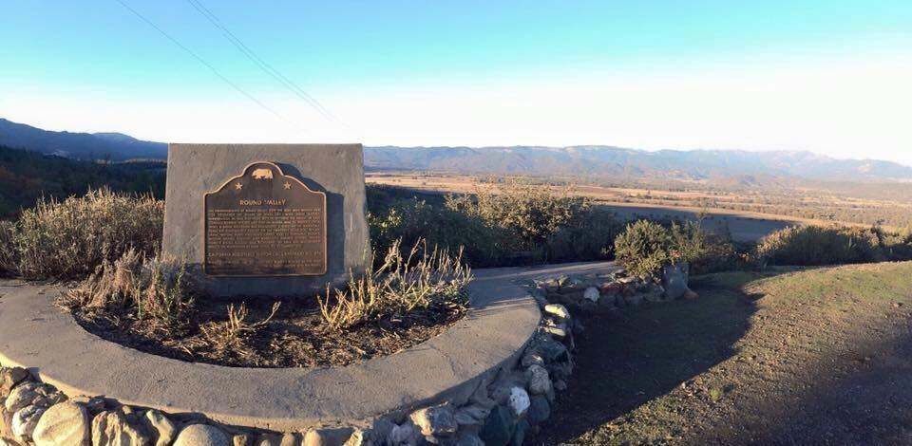
Closing and Questions

